Slide 1
Temporal Costmap Aggregation:
Mitigating Distribution Shift in Object-Relative Visual Navigation
Kewei Liu · Zihang Zhou · Zihao Long
github.com/6chHenry/object-rel-nav

Slide 2
Problem & Motivation
ObjectReact conditions a local navigation controller on a per-frame WayObject Costmap instead of raw RGB, giving strong cross-embodiment generalization.
The controller is feed-forward and trained by behavior cloning, so it inherits imitation learning's classic failure: distribution shift.
The costmap is recomputed every frame from segmentation and matching. A single corrupted frame drives the policy toward a wrong waypoint, with no temporal signal for recovery.
Our insight: a short window of consecutive costmaps carries redundant spatial cues and a smooth temporal trend (like a driver who briefly loses sight of a sign relying on the recent past).
Central question: can a lightweight temporal-memory module recover robustness, and is a confidence-gated aggregator needed beyond plain temporal memory?

Slide 3
Related Work & Background
Object-relative navigation: RoboHop -> TANGO -> ObjectReact. All operate on single-frame observations. ObjectReact is the baseline we extend.
Imitation learning & distribution shift: behavior cloning compounds errors off-distribution. Remedies include DAgger and history-conditioned recurrent policies.
Temporal modeling in navigation: GNM / ViNT fuse a short RGB history; ObjectReact dropped this for its goal encoder.
Gap we target: no prior work applies a temporal aggregator, let alone a confidence-gated one, to an object-relative costmap representation.

Slide 4
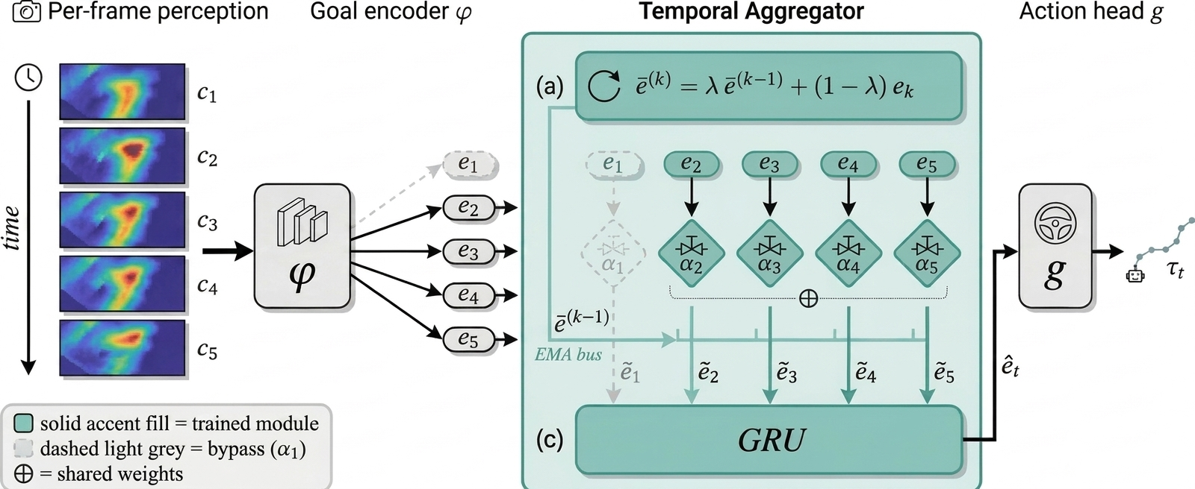
Technical Approach: Temporal Aggregator
Keep encoder φ and waypoint head g (warm-started from the public checkpoint); insert aggregator 𝒜 over a sliding window of K frame embeddings:
$$τ_{t} = g({\hat{e}}_{t}), {\hat{e}}_{t} = 𝒜(e_{t−K+1}, …, e_{t})$$

Slide 5

Three Learned Aggregators
1. Plain GRU
Single-layer GRU (hidden 1024) over the window; take the last hidden state.
$${\hat{e}}_{t} = GRU(e_{t−K+1}, …, e_{t})$$
2. Cosine-confidence-gated GRU
Scalar confidence from cosine similarity to an intra-window EMA; blend before the GRU. Adds only 2 scalar parameters.
$$α_{j} = σ(w · cos(e_{j}, {\overline{e}}_{j−1}) + b)$$
$${\tilde{e}}_{j} = α_{j} e_{j} + (1 − α_{j}) {\overline{e}}_{j−1}$$
$${\hat{e}}_{t} = GRU({\tilde{e}}_{t−K+1}, {\tilde{e}}_{t−K+2}, …, {\tilde{e}}_{t})$$
3. Reliability-gated GRU
Same mixing, but αⱼ comes from a learned 2-layer MLP over per-channel disagreement signals (diff, product, cos, norm-ratio). Adds ~0.52M parameters.
$$α_{j} = σ(s_{ψ}([e_{j} ; {\overline{e}}_{j−1} ; d_{j} ; p_{j} ; c_{j} ; δ_{j}]))$$

Slide 6
Experimental Setup
Benchmark: HM3D InstanceImageNav in Habitat-Sim, with ground-truth topometric.
Four tasks: Imitate, Alt-Goal, Shortcut, Reverse (33 / 23 / 26 / 30 effective episodes).
Metrics: Success Rate (SR), SPL, Soft-SPL. Single full evaluation protocol for every run.
Design: a 2x2 study of training corruption probability (0.0 or 0.2) crossed with inference corruption probability (0.0 or 0.2).
Inference corruption: the current costmap is replaced by a zero map with probability 0.2. Within each cell, all architectures share initialization, data, seed, window, and protocol.

Slide 7
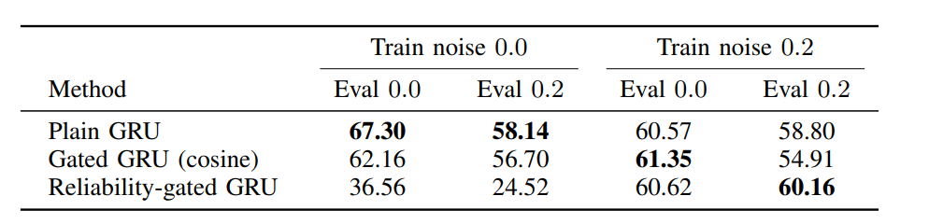
Results: Avg SPL over the Four Tasks
Without training corruption, reliability gating is weakest and collapses (36.6 -> 24.5).
With matched training corruption, the three clean averages nearly tie (60.6 - 61.4 SPL).
Under inference corruption, the reliability-gated GRU is strongest at 60.16 SPL.

Slide 8
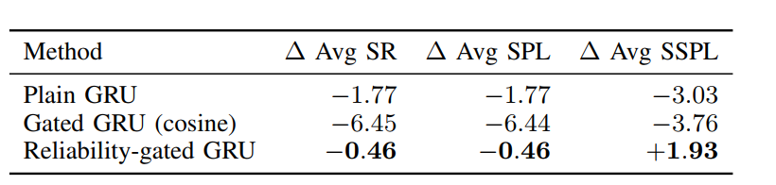
Robustness: Clean -> Noisy SPL Loss (matched training)
Avg over the four tasks; higher Δ is better (closer to 0 = more robust).
Reliability-gated GRU loses only 0.46 SPL under corruption and even gains +1.93 Soft-SPL; cosine gating loses 6.44.
It reaches 60.2 Avg SPL under corruption: 1.36 above the matched Plain GRU and 5.25 above the matched cosine-gated GRU.
Training corruption alone lifts the reliability-gated GRU from 24.5 to 60.2 noisy SPL; the benefit is specific to this jointly-trained architecture, not a generic augmentation effect.

Slide 9
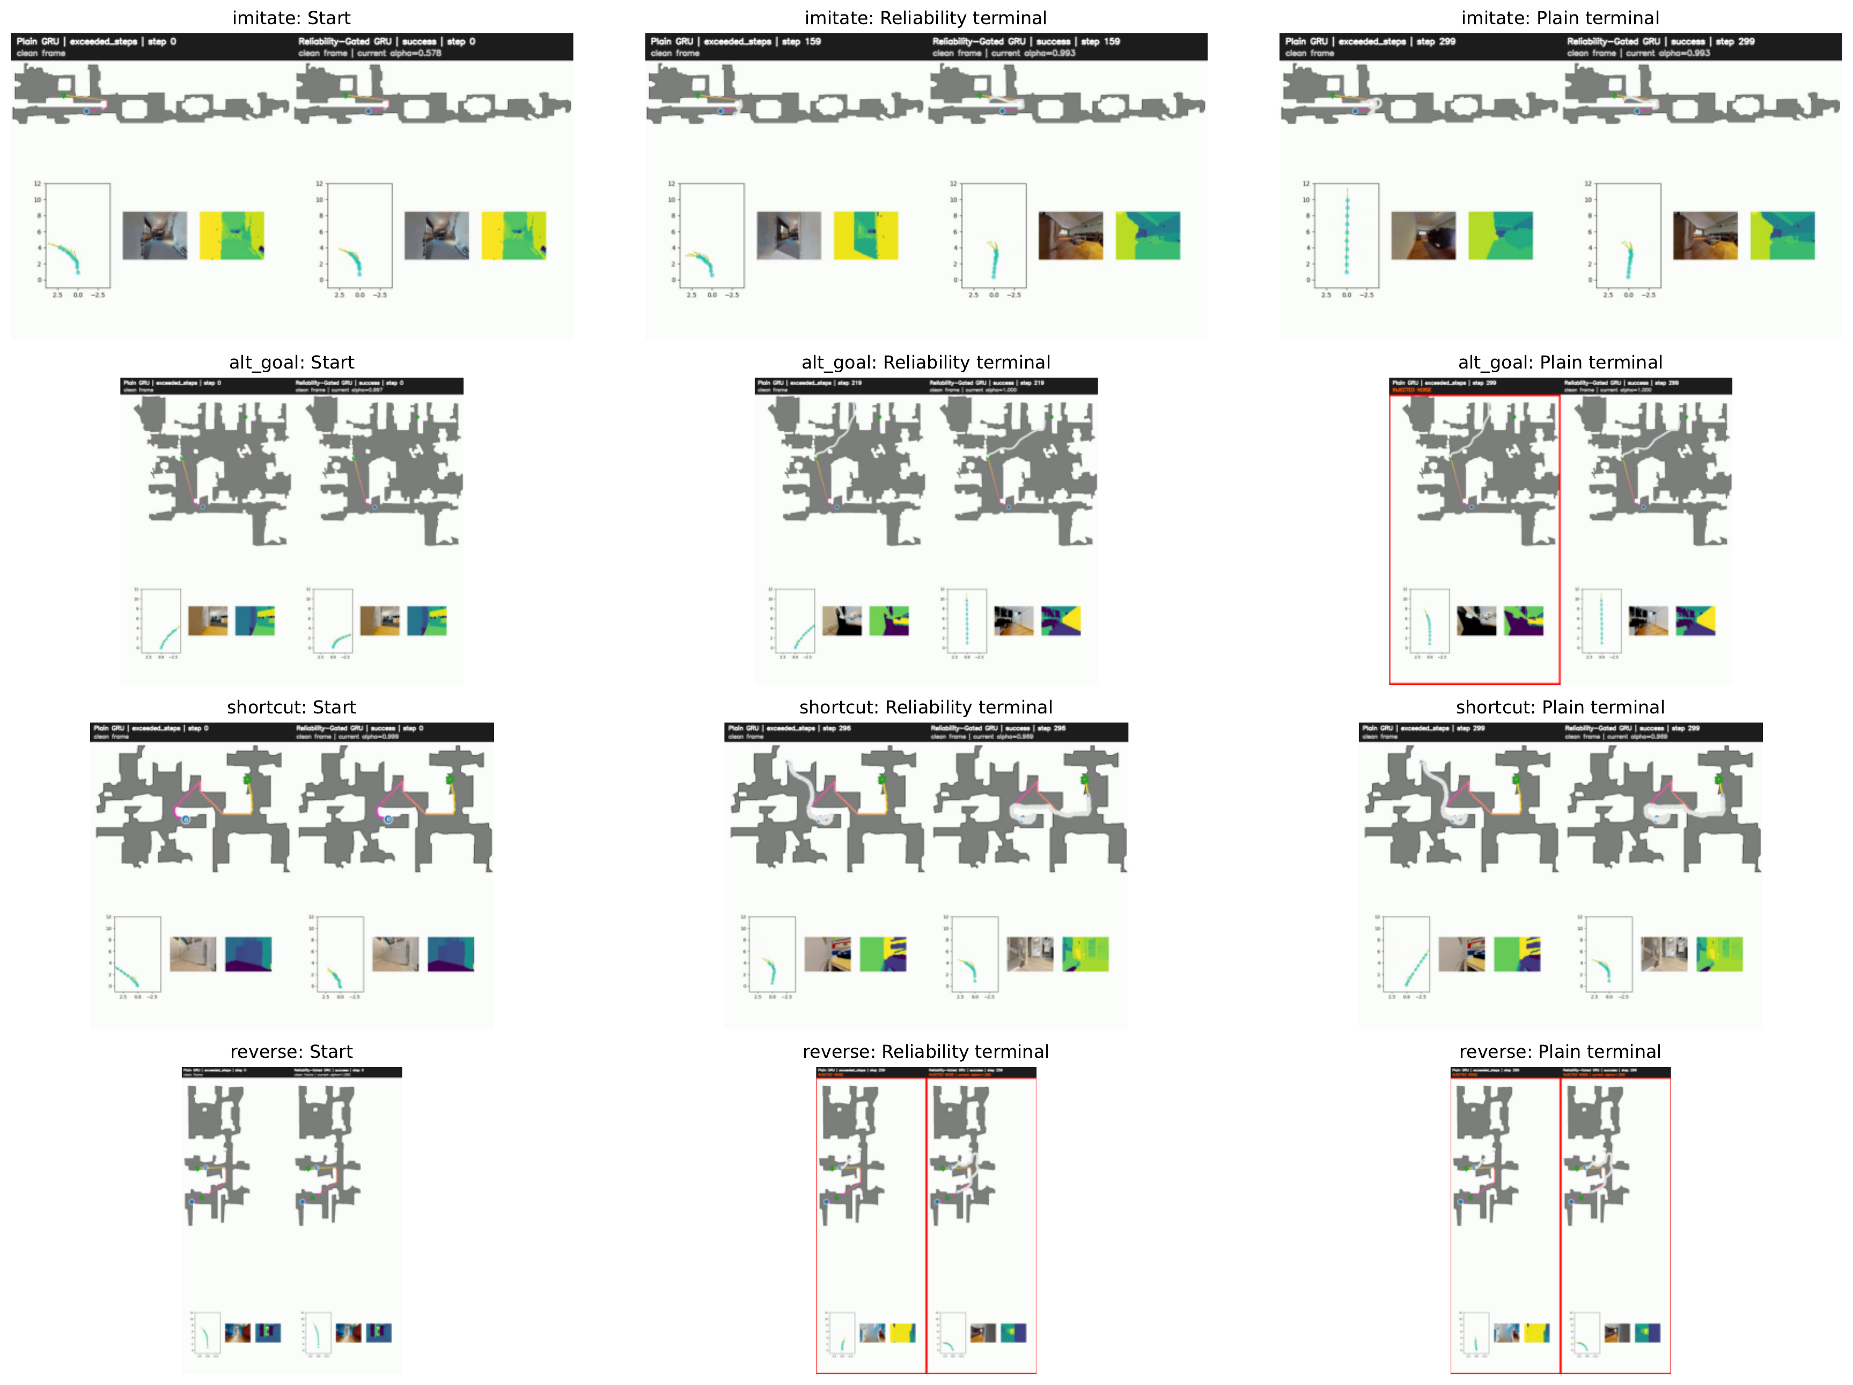
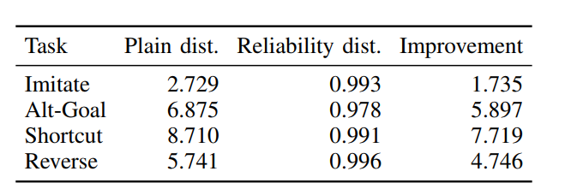
Matched Qualitative Rollouts (inference noise 0.2)
Per task, the selected episode is one where reliability gating succeeds and Plain GRU fails.
Plain GRU hits the 300-step limit in all four; the reliability model reaches within ~1 m.
These illustrate the recovery mode, not population frequency.

Slide 10
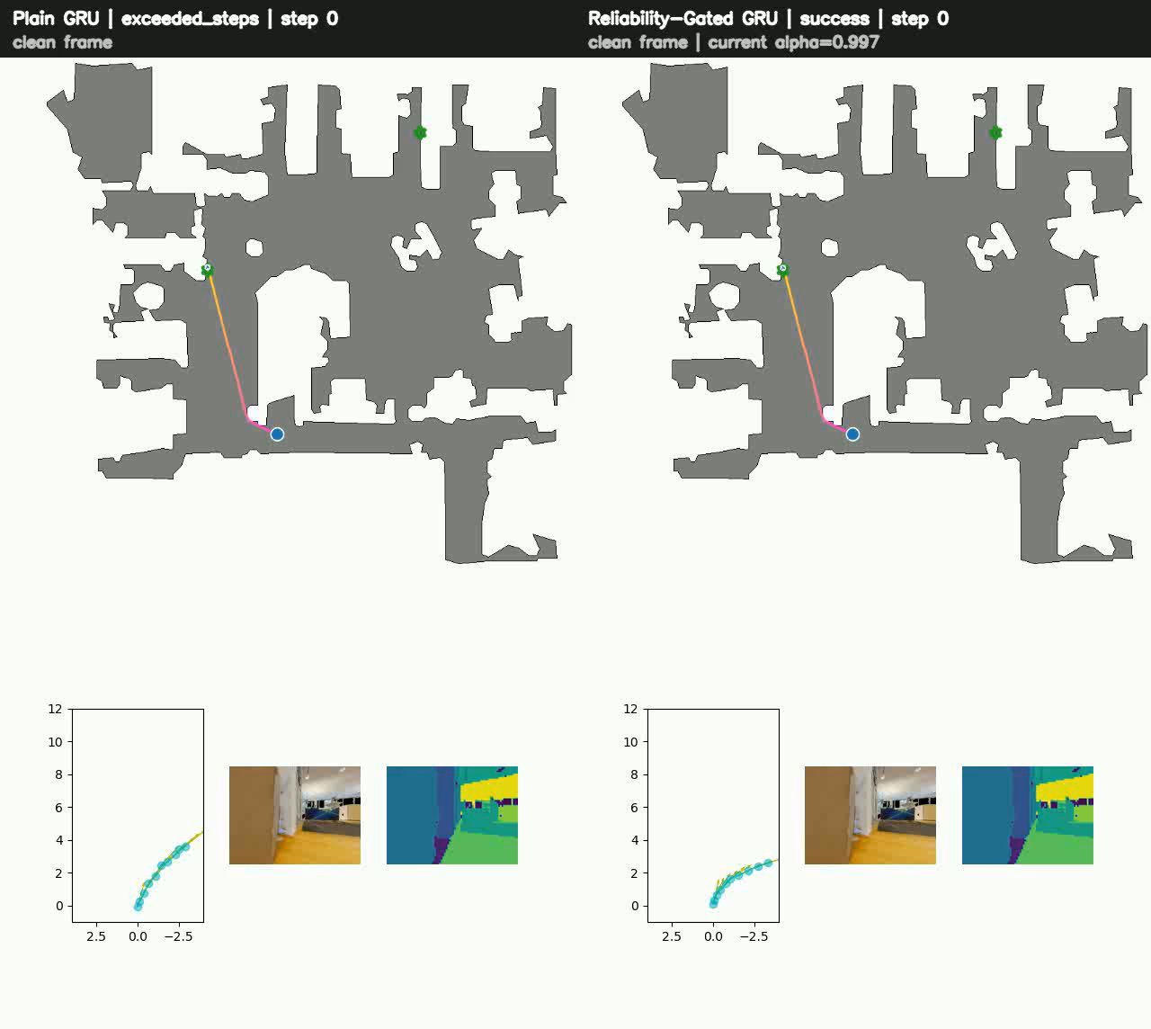
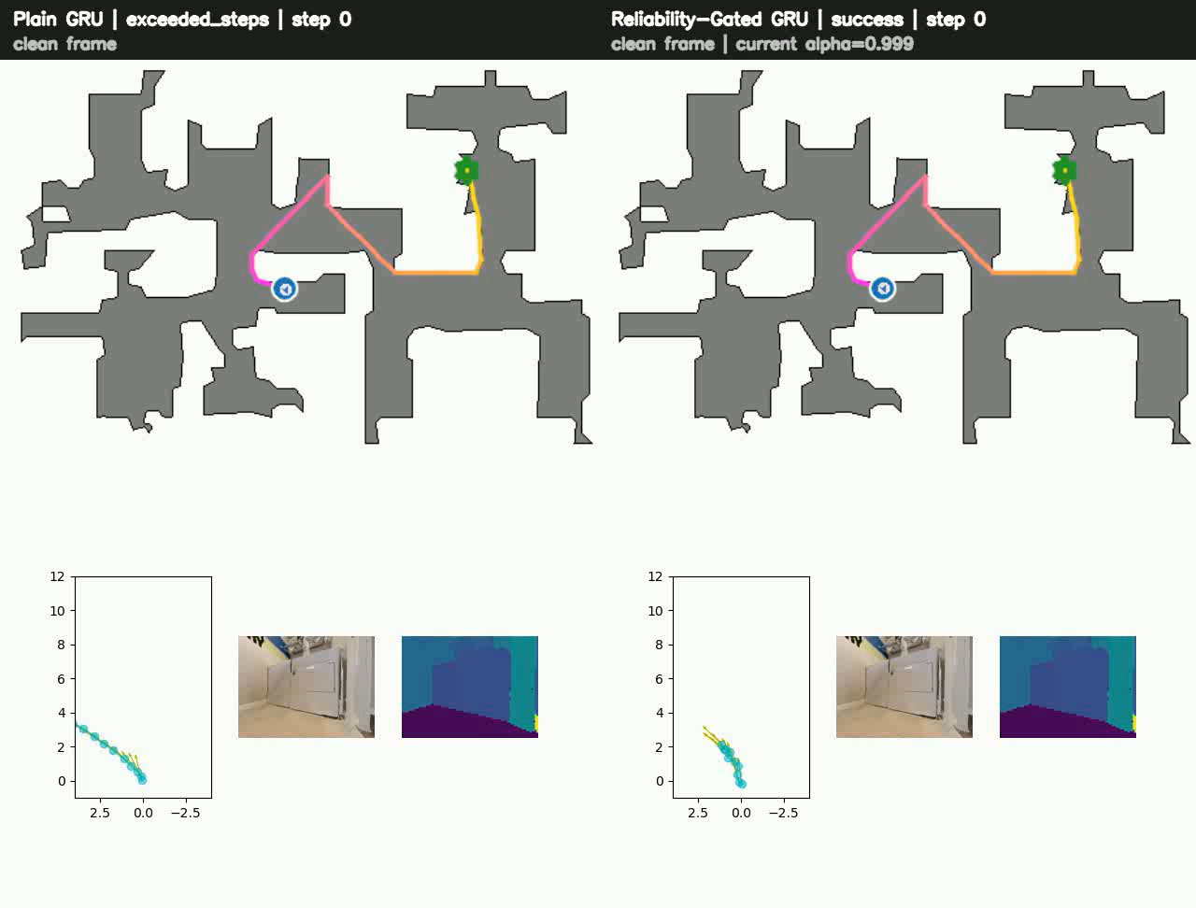
Alt-Goal
Shortcut

Slide 11
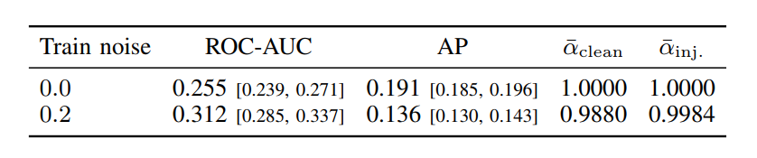
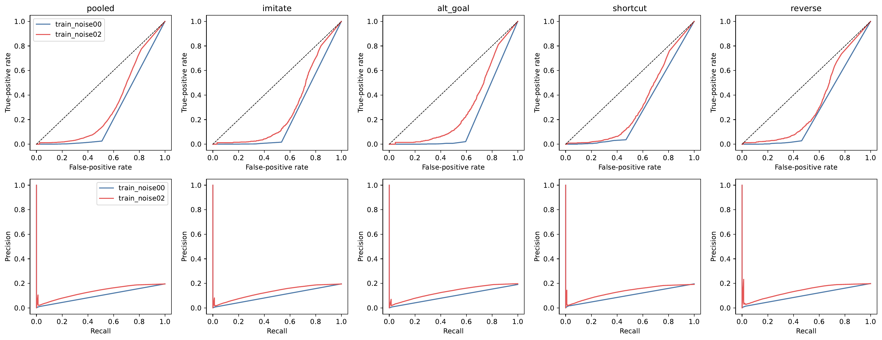

Does the Gate Detect Corrupted Frames?
$${\tilde{e}}_{j} = α_{j} e_{j} + (1 − α_{j}) {\overline{e}}_{j−1}$$
Corruption-detection score:
$$1 − α_{t}$$
Pooled ROC-AUC = 0.312 (below 0.5, i.e. worse than chance).
Backwards semantics: injected frames get mean α = 0.9984 vs 0.9880 on clean frames.
The gate is NOT a calibrated failure detector. The navigation gain is a behavioral property of the jointly-trained recurrence.
Explicit corruption supervision or a calibration loss is needed before α can be read as reliability.

Slide 12
Conclusions & Future Directions
Conclusions
Corruption-trained reliability-gated recurrence is the strongest, most stable model under inference noise: 60.2 SPL with only a 0.46-point loss.
Four matched rollouts confirm recovery cases across all tasks.
The strongest supported conclusion is behavioral; explicit supervision is needed to make the gate itself reliable and explainable.
Future directions
Inferred-perception evaluation: replace ground-truth segmentation with FastSAM + LightGlue.
Multiple seeds and a sweep over inference-noise levels.
Explicit gate supervision: add a corruption-classification or calibration objective so low alpha has a real reliability meaning.

Slide 13
Thanks for Listening

